Slide 1
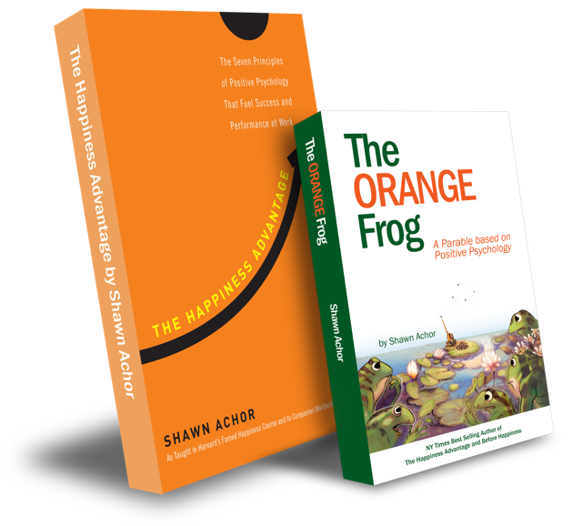
The Happiness Advantage
and
The Orange Frog
By Shawn Achor

Slide 2
High School Week One

Slide 3
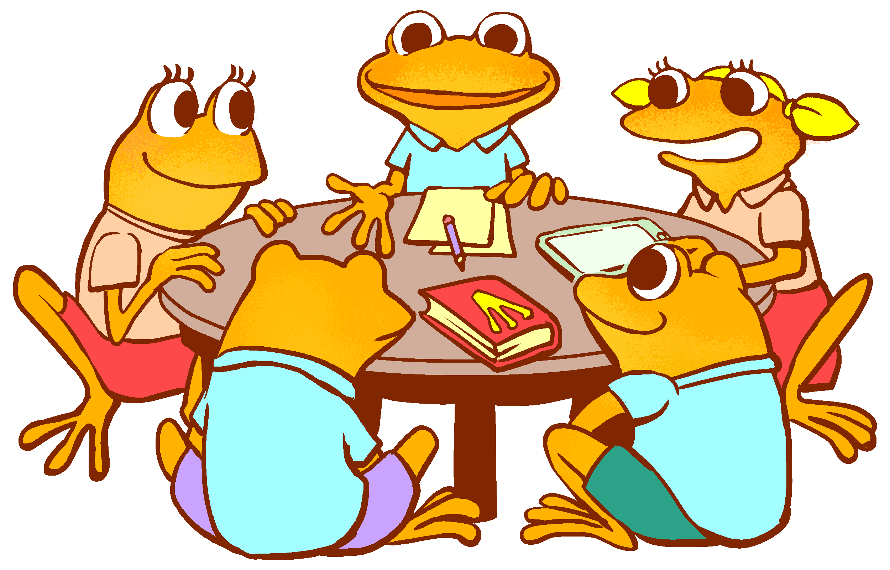
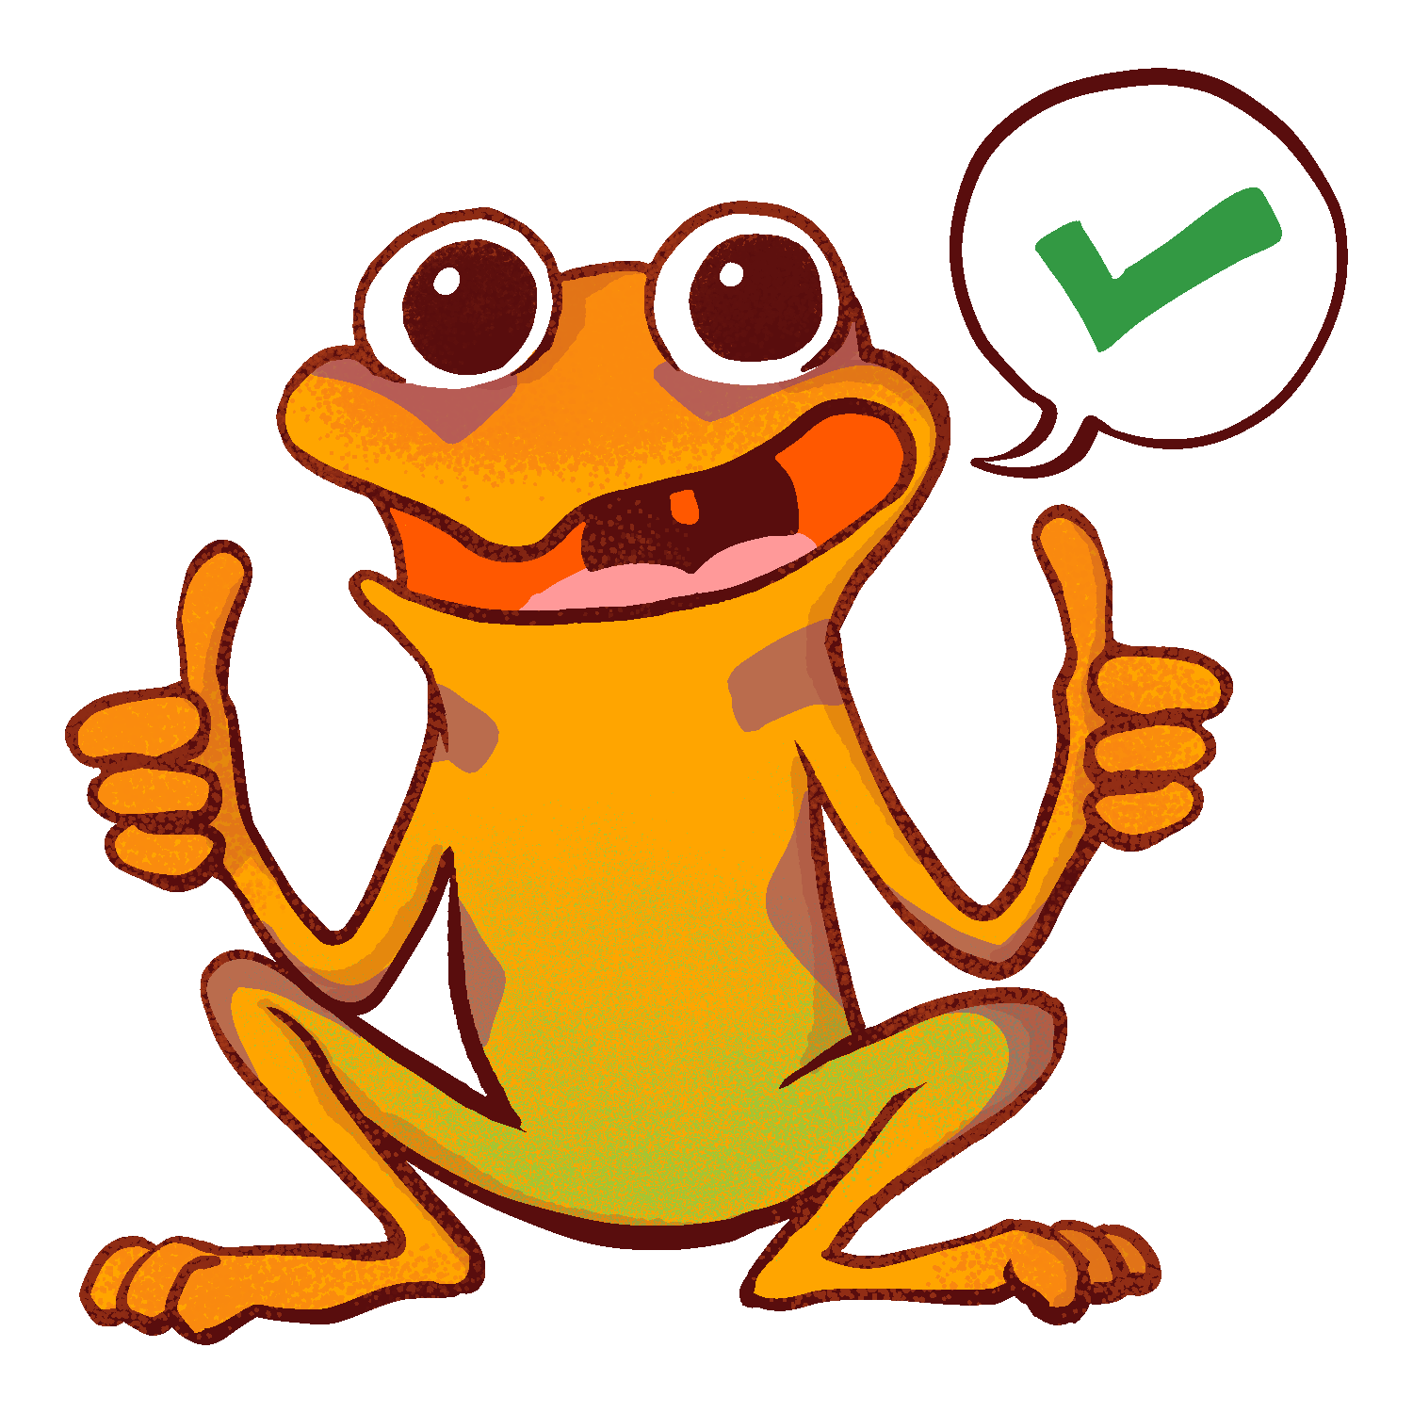
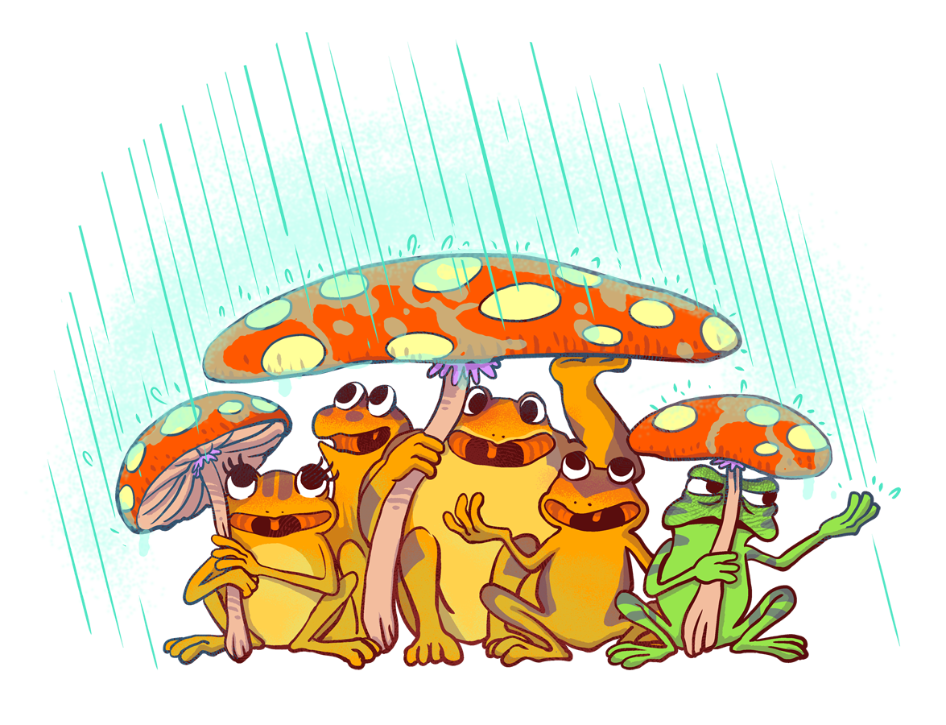
The Orange Frog
P 1
Learning Objective:
I can read the Orange Frog Parable.
I will discuss the central theme of the Orange Frog and will discover connections for my everyday life.
Notes:
Standard:
Essential Concept: Communicate and work productively with others emphasizing collaboration and cultural awareness to produce quality work.
Skill:
Interact positively as a team member.
Cooperate with others in a group setting.
Generate ideas with group members.
Are active listeners.
Read and understand information in a variety of forms.
Express ideas.

Slide 4
Skills
Interact positively as a team member.
Cooperate with others in a group setting.
Generate ideas with group members.
Are active listeners**
Read and understand information in a variety of forms.
Express ideas**

Slide 5
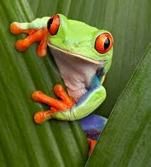
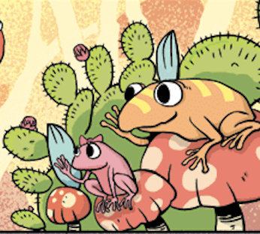
Questions
“When you hear the word positive, what do you think of?
“Would you say that you are a positive person by nature?”
“Would you say it’s ‘trendy’ to be positive? Or is it more ‘trendy’ to be angsty and mad?”
“Has anyone read the Orange Frog?”
Notes:
Facilitate discussion with students. When they seem to be wrapping it up, tell them, “We are going to read a parable. Can anyone tell me what a parable is?” Take answers
“According to Miriam Webster’s dictionary, a parable is -- a simple story used to illustrate a moral or spiritual lesson. Other examples of parables would be, “The little boy who cried wolf” or “The Three Little Pigs”.
Each of these stories teach a moral or a lesson. The lesson of “The Little Boy Who Cried Wolf” was to be honest. The lesson of The “Three Little Pigs” was to work hard and be patient.
I don’t want to give too much away, but the story of The Orange Frog teaches quite a lesson. We will follow Spark on a journey of self-discovery, self-expression and self-care”.
Access the electronic book here -- https://www.orangefrogschools.com/high-school/ofbook
Read about Shawn Achor aloud to students. (Pg. 91 in physical, or About the Author in digital)
You can either project the “The Orange Frog” on the board, read to the students, have them volunteer to read aloud, or ask them to read chapters 1-2 to themselves.

Slide 6
Introducing The Orange Frog

Slide 7
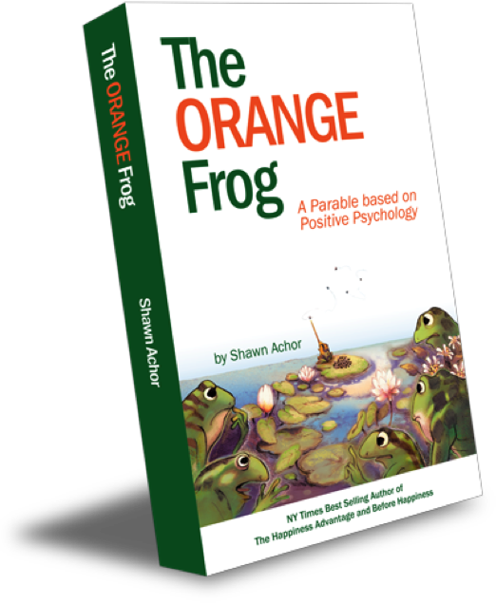
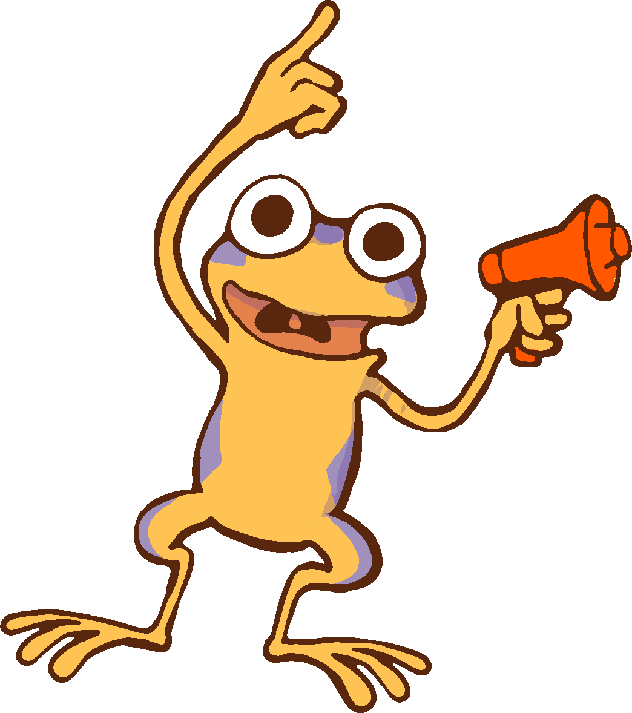
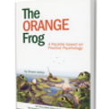
Finding the Orange Frog Comic
All Right!
Let’s Read Chapters
1 & 2
Stopped here
Notes:
Read aloud to students.
About the Author
Author of The Happiness Advantage, Shawn spent over a decade at Harvard University where he won numerous distinguished teaching awards for his work. He graduated magna cum laude from Harvard Divinity School in Christian and Buddhist ethics. In 2006, he was Head teaching Fellow for "Positive Psychology," the most popular course at Harvard at the time. In 2007, Shawn founded Good Think Inc. to share his research with a wider population. When the global economy collapsed in 2008, Shawn was immediately called in as an expert by the world's largest banks to help restart forward progress. Subsequently, Shawn has spoken in 45 countries to a wide variety of audiences: bankers on Wall Street, students in Dubai CEOs in Zimbabwe. Shawn's research on happiness and human potential have received attention from the Harvard Business Review, New York Times, Forbes, CNN, and NPR.

Slide 8
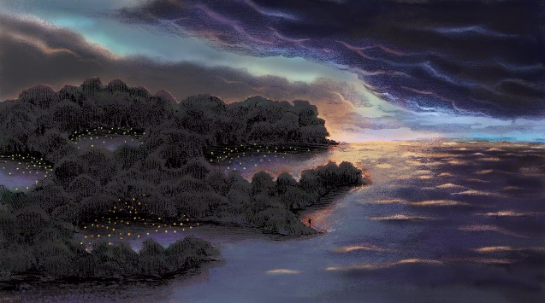
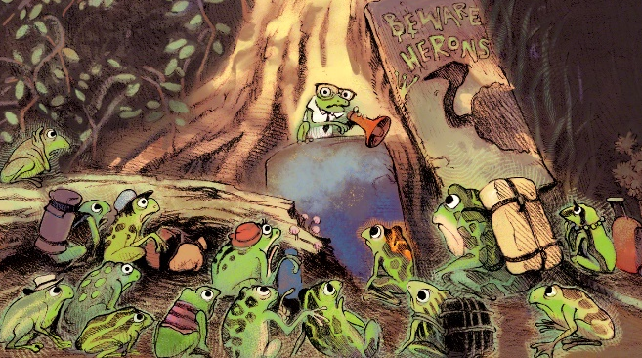
Thoughts
The Thrall | The Deluge | Transition Week
“Changes Perspective & Color. Makes Life less vibrant No Coughing, no Shakes & no Warts | Something we cannot stop. Something we can be ready for. | Coming of Age Trying to “Fit In”
Notes:
The Orange Frog is a parable. What is a parable?
Listed in the slide above are three important metaphors in the Orange Frog. Facilitate discussion with the class – what do they mean in the story, and how might it apply to my life?
Thoughts:
“The first parts or even words of the book seem incredibly descriptive. The author takes some time to reveal different key concepts. One of the things we learn, several times actually, is that the author is in fact a scientist. He seems quite persistent that we know he’s a scientist and this is the rationale for some of his decision making. Why do you think he takes the time to tell us that? More than once even. ”. Take discussion. Lead the students to understand that Shawn let’s us know this fact, because it builds interest, and credibility.
“The author also spends some time telling us about a disease. It’s a disease unlike any other disease. What do you recall him telling us?” Jot down ideas on the board.
The Thrall --
- Changes perspective
- Changes the color of the frog
- Makes life less vibrant, and more dull Doesn’t make you cough
- Doesn’t make you grow arts (Although, warts are alluring)
Doesn’t make you shake
“We then start to grasp other important events. We hear from the author about the Deluge, and theories centering around it. We learn that Transition week is much like a holiday to be celebrated. Can anyone connect Transition Week to everyday life? The herons are talked about like a looming threat. What in your everyday life can be compared to the
herons?” Lead students to discuss ‘coming of age’ or moving from pre-teen to teenage
years.
“It’s easy being green is by far the truest statement. We learn that Spark is different. Spark isn’t just changed on the outside, but he is changed on the inside too. As readers, we meet three other frogs that were a part of transition week. Misty, Bull and Plop also notice the changes in Spark and ask questions like, “Are you sick?”. Spark seems to be a bit resistant to
being different, at first. Why do you think that is?”. Allow discussion to take place.
Click through the slide to see the answers revealed.

Slide 9
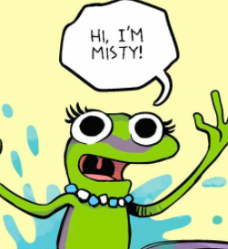
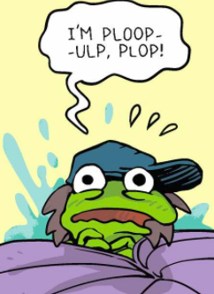
Action
“Have you ever had a time when you wanted to be like everyone else? When you wanted to hide your differences to fit in?”.
“I wanted to be like everyone else when __________________”.
“I felt different because ______________”.
Notes:
Action:
Ask the students to have an elbow partner discussion -- “Have you ever had a time when you wanted to be like everyone else? When you wanted to hide your differences to fit in?”.
“I wanted to be like everyone else when __________________”.
“I felt different because ______________”.
**Example: “A time when I wanted to hide my differences was when I had to take school pictures, as a child. I had these big giant dimples. Everyone used to call me crater face. It made me sad to know that I was different, and I just wanted to be like everyone else”.

Slide 10
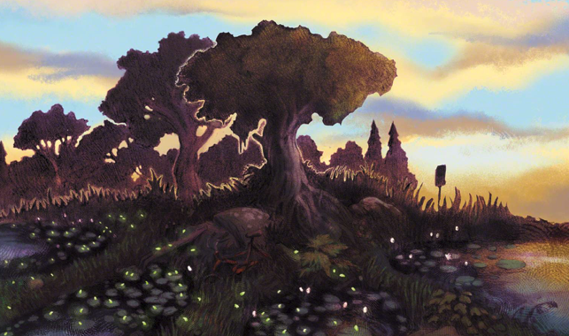
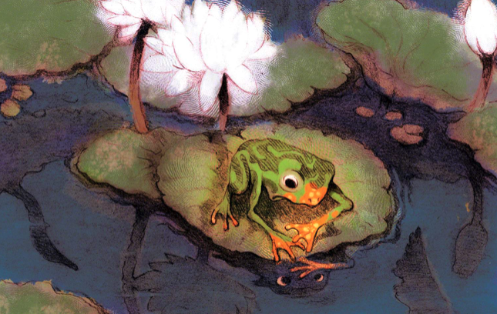
Bonus Questions
Let’s make a connection. What is the Thrall in the “real world”? What can you connect it to? What evidence do you have from the text?
Based on the reaction of others, is being Orange a good thing? Is it “normal”?
What is Spark's immediate solution to his “problem”?
Why do the other frogs seem scared about Spark being Orange? What is the real threat?
Have you ever had to make a choice about being positive?

